Slide 1
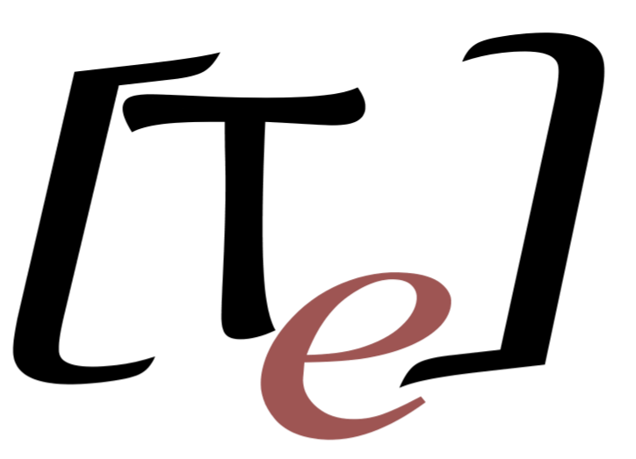
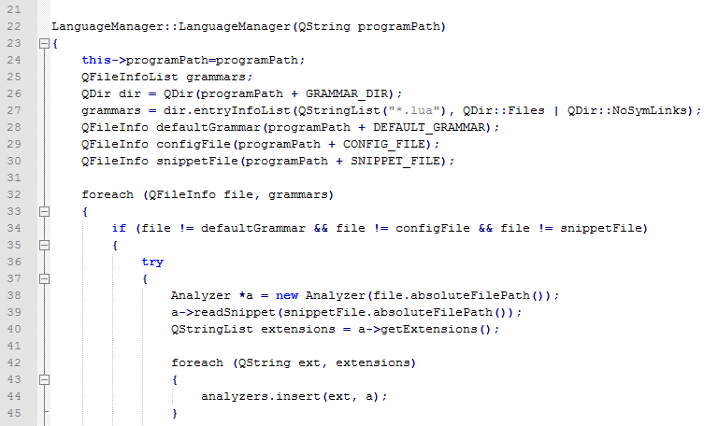
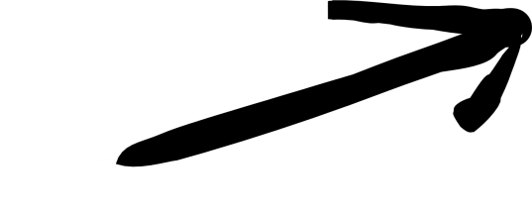

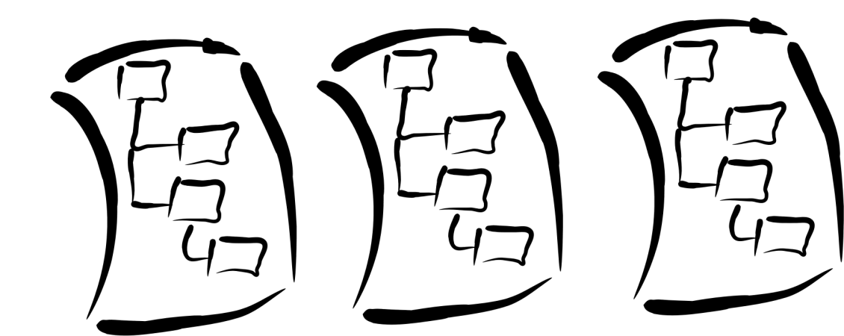


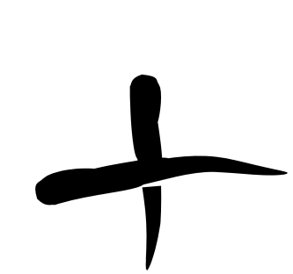

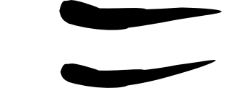
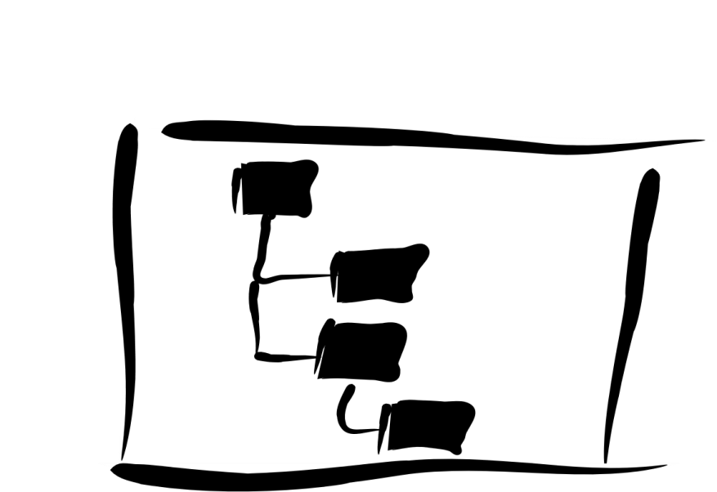
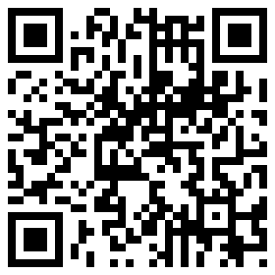
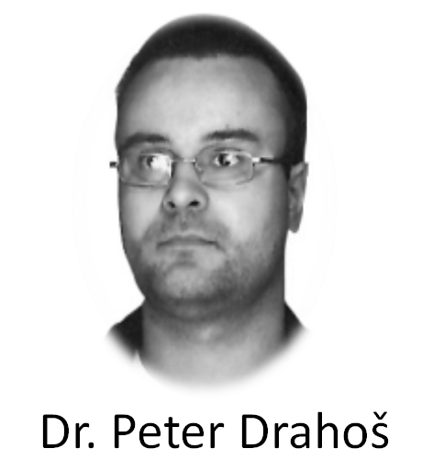


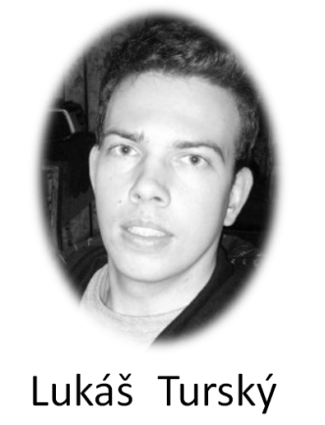
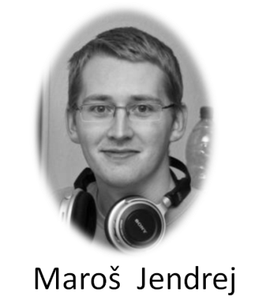
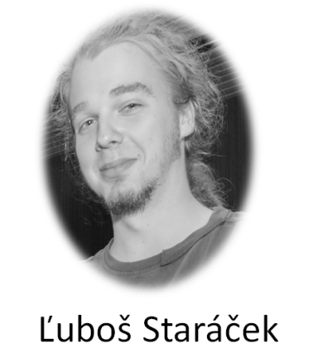


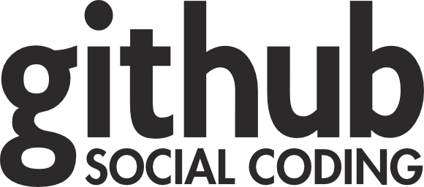

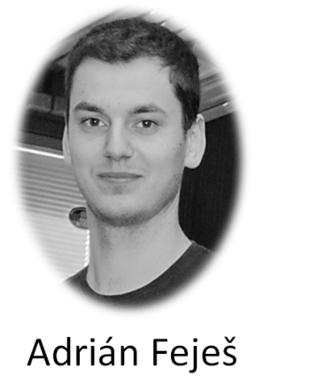
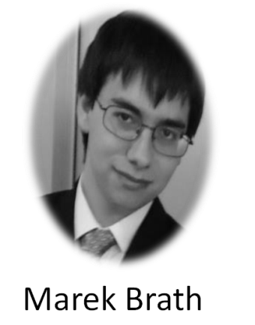

TrollEdit
New way of source code editing
OverView
Introduction
Today editors usually use simple color highlighting without any sign of graphic enrichment features. However enriching the source code with graphic elements can be beneficial for the understanding of the structure of given code and thus lead to better understanding of its structure and meaning for the programmer. This basic observation is the driving idea behind TrollEdit.
Aproach
Ako sa vytvara gramitka, že je to postavne na PG bezkontextovych gramatikach z kotrých je vytvarani AST strom, ktory nam umožnuje repezentaciu textu formou blokov.
Application
Trolledit is an experimental applicaton based on multiplatform framework Qt. For parse source code and creating AST we usesing simple a scripting language LUA.
How to see source code
classical a text editor
How to see source code
TrollEdit
Why to used TrollEdit?
Simple a easy using
Code structure visualizazion as blocks
More opened files in a workspace
Selection and movement files after a workspace
Insert files (Img. Link, etc.) into code
We can this see better?
Yes, answer is TrollEdit
Write documentation into code (Literate programming as D. Knuth)
Can works in two modes as simple text and with graphical elements
Grammars
Source
Source with graphical enhancements
Conclusion
Čo sa nam podarilo zhnutie t.j. niečoho noveho čo dopisal nexisutje.
Na vyvoji nadalej prokračujeme a budeme radi ak sa knam pripojite do skupiny a pomožete tak vytvorit niečo originalne.
S pozdravom
Team Innovators
AST
Team
Used technology
© 2012 Team Innovators
tp-team-10@googlegroups.com

